Slide 1
Lecture 11 Computer Networks COMP1411: Introduction to Computer Systems
Dr. Mingsong LYU (呂鳴松)
Department of Computing,
The Hong Kong Polytechnic University
Spring 2023
Acknowledgement: These slides are based on the textbook (Computer Systems: A Programmer’s Perspective) and its slides.
These slides are only intended to use internally. Do not publish it anywhere without permission.

Slide 2
Main message
Understanding the basic concepts of networking
Understanding simple network programming
This lecture serves as a very simple introduction to networking
Networking deservers a complete course COMP2322

Slide 3
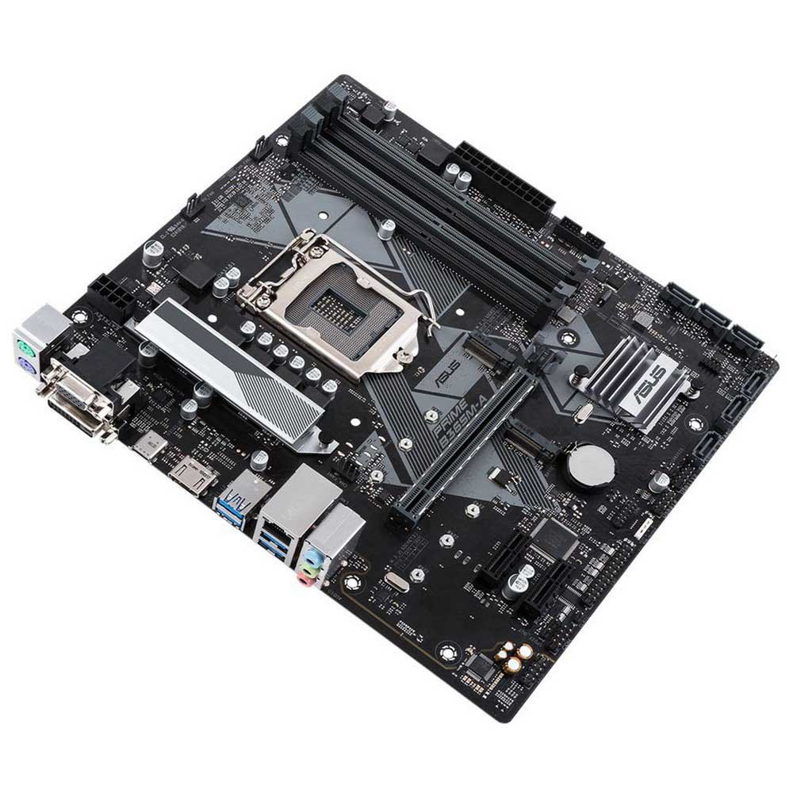
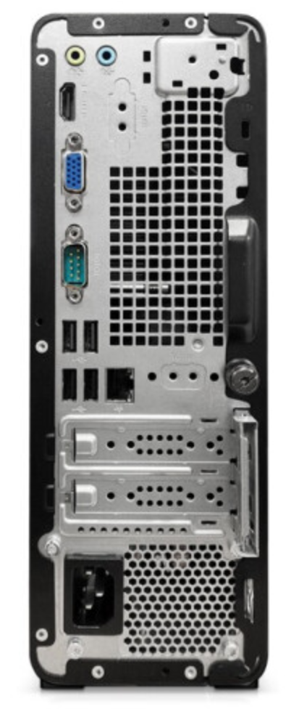
A computer is not a closed box
Network interfaces – I/O device for networking
Network interface

Slide 4


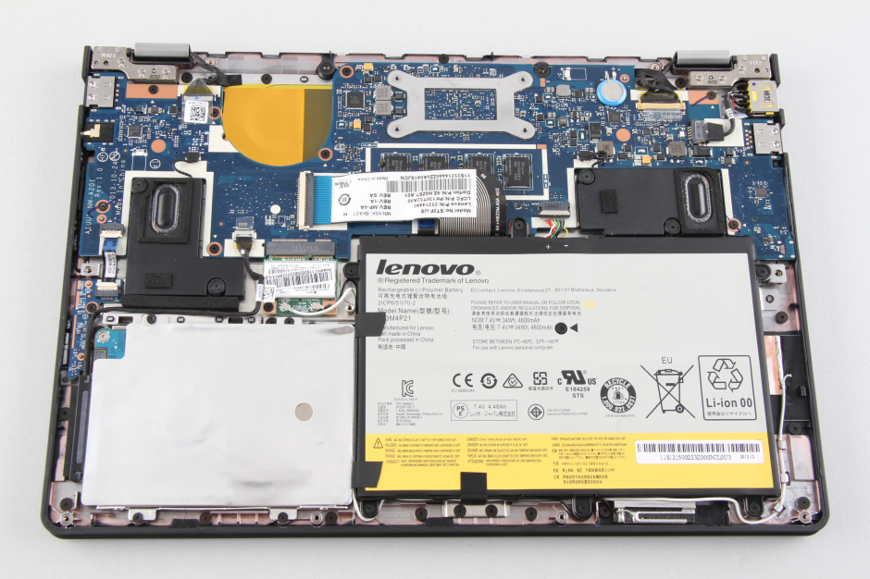
A computer is not a closed box
Network interfaces – I/O device for networking

Slide 5
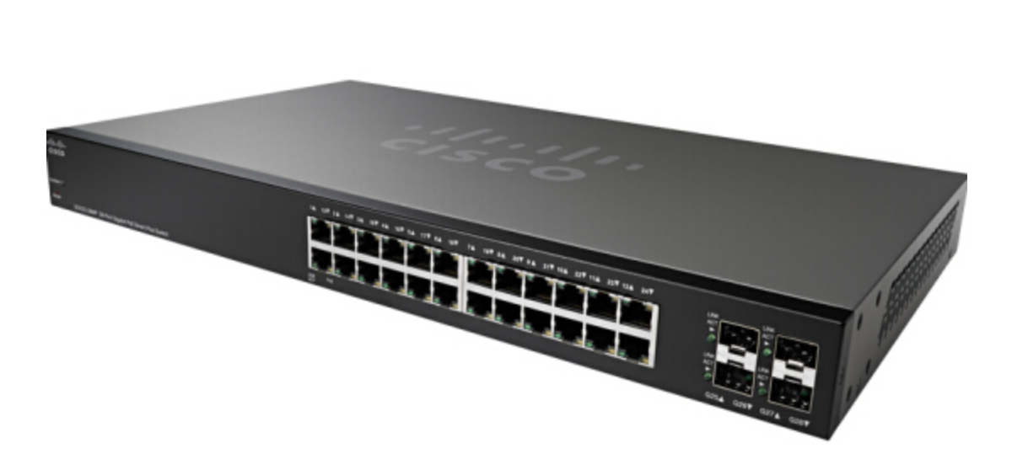

How computers are connected
LAN – Local Area Network
Connecting a small number of computers with switches/HUBs
Bus/Switch
Switch
HUB

Slide 6
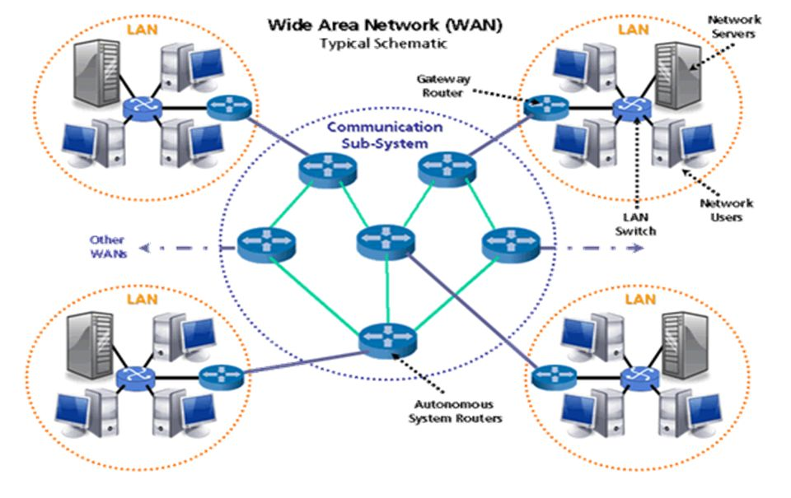
How computers are connected
WAN – Wide Area Network
Multiple LANs connected by routers (transmitting data among LANs)
The foundation of the Internet

Slide 7
How computers find each other
IP address: To locate a computer in the network
Each network interface has a unique MAC address
hardcoded when the interface hardware is produced
like your HKID
Each computer is assigned an IP address, configurable
like your home address
The MAC address is bind with an IP address when your computer is connected to some network
For your smartphone, at home, you have an IP address; when you connect to the WIFI in Starbucks, you have another IP address
An IP address is a 32-bit integer
128.2.203.179
We focus on IPv4, which uses 32-bit addresses
The new version is IPv6, which uses 128-bit addresses
IP addresses are used by routers to forward data packets

Slide 8
How computers find each other
But when we surf the Internet, we use
www.google.com
www.polyu.edu.hk
www.youtube.com
……
IP addresses are hard to remember
Computers in the networks can be assigned a domain name
Human-friendly structured string
apollo.comp.polyu.edu.hk → 158.132.xxx.xxx
Mapping between domain names and IP addresses are stored on domain name servers, mapping service is provided by these servers

Slide 9
How computers find each other
But I am running my program, chrome, word… on my computer, how does another computer know that “my program”, not chrome, is communicating with it?
Port number
Loosely speaking, a port number is used to uniquely identify a process on the computer
Client socket address
128.2.194.242:51213
Server socket address
208.216.181.15:80
Client
Server
(port 80)
Client host address
128.2.194.242
Server host address
208.216.181.15

Slide 10

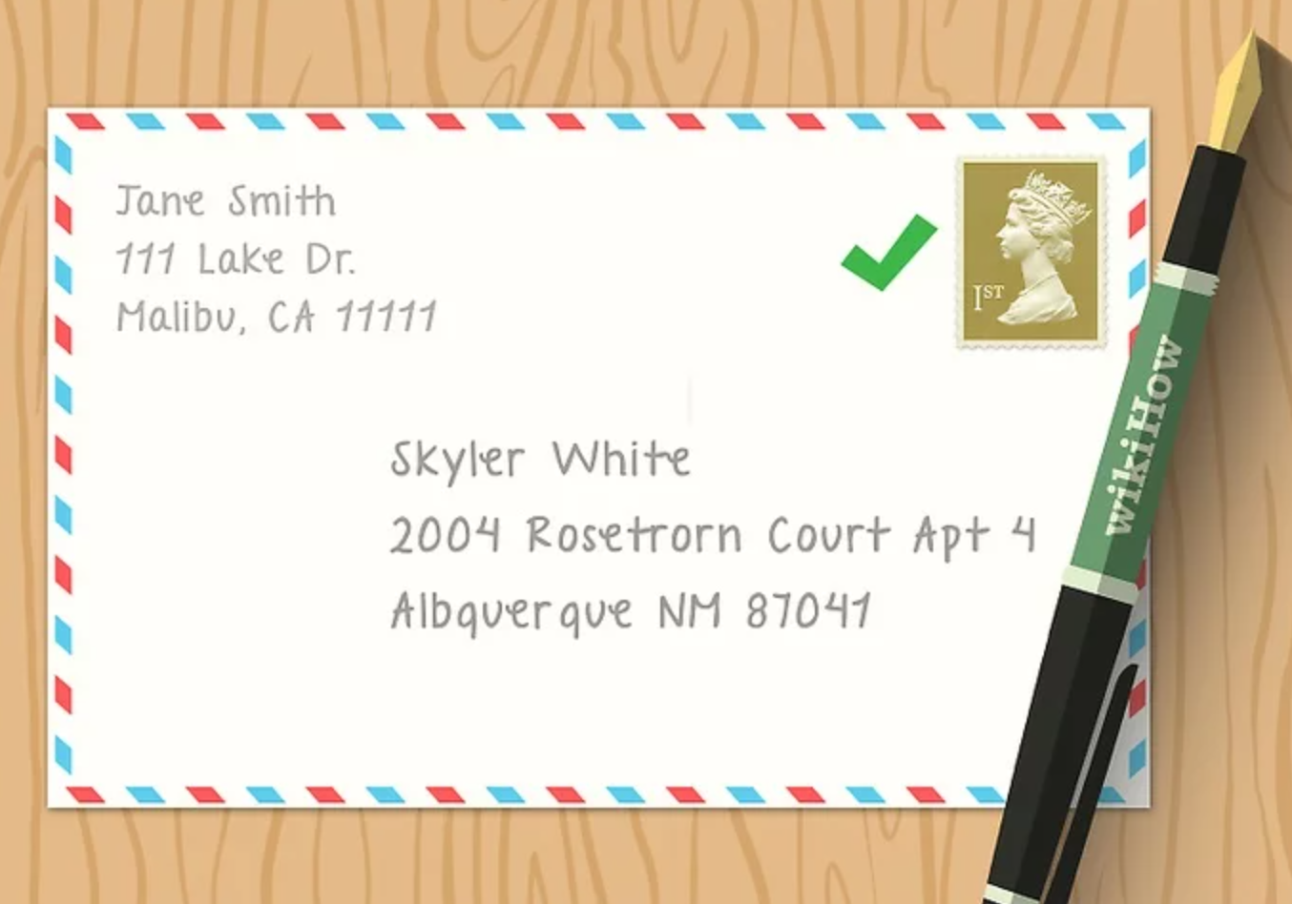

Data packets
Think of mailing a letter…

Slide 11
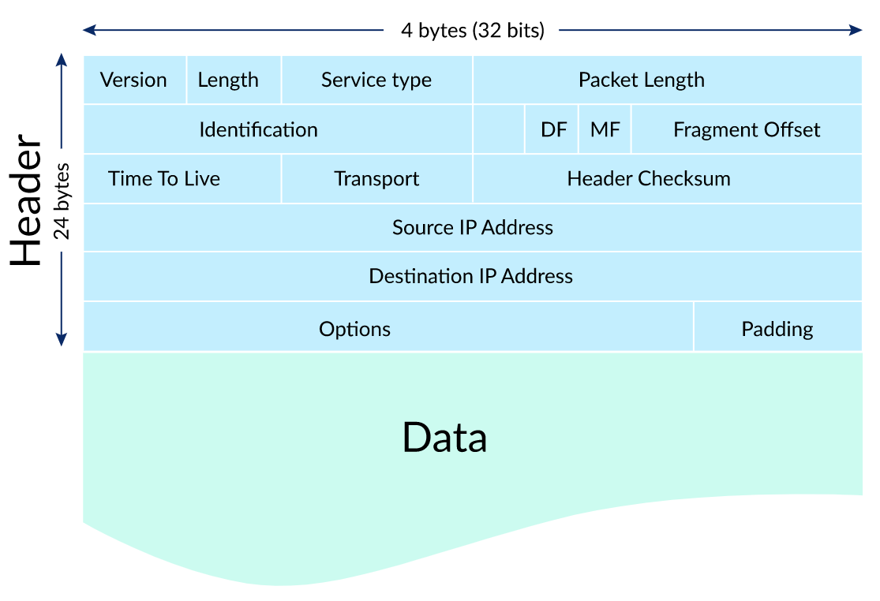
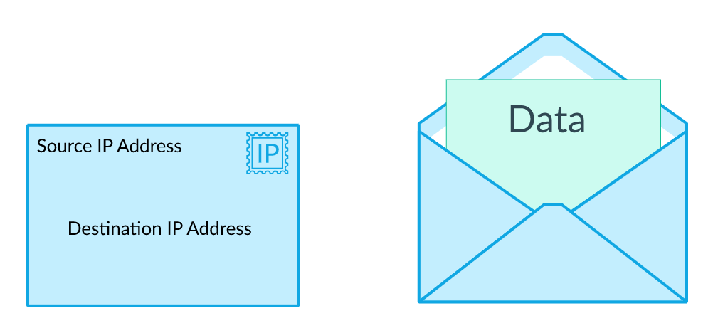
Data packets
Headers
Pre-defined data structure containing important information for the data to be transmitted in the network, such as IP addresses, packet length, etc.
Payload
The data, usually a specified number of bytes
To transmit large data, trunk them into smaller packets

Slide 12
Data packets
Software running on each computer and the routers manage data transmission by manipulating the headers
LAN1
Host A
Host B
LAN2
client
server
(1)
data
(8)
data
protocol
software
protocol
software
internet packet
(2)
data
PH
FH1
(7)
data
PH
FH2
LAN1 frame
LAN1
adapter
LAN2
adapter
Router
(3)
data
PH
FH1
LAN1
adapter
LAN2
adapter
(6)
data
PH
FH2
LAN2 frame
(4)
data
PH
FH1
data
PH
FH2
(5)
PH: Internet packet header
FH: LAN frame header
protocol
software

Slide 13
Socket programming
The socket interface
A set of functions that are used in conjunction with the Unix I/O functions to build network applications
Client
Server
getaddrinfo
getaddrinfo
socket
socket
open_listenfd
open_clientfd
bind
listen
Connection
request
connect
accept
Client / Server
Session
write
read
Await connection
request from
next client
read
write
close
EOF
read
close

Slide 14
Socket address structures
The socket address
From the perspective of the Linux kernel, a socket is an end point for communication
From the perspective of a Linux program, a socket is an open file with a corresponding descriptor
struct sockaddr_in {
uint16_t sin_family; /* Protocol family (always AF_INET) */
uint16_t sin_port; /* Port num in network byte order */
struct in_addr sin_addr; /* IP addr in network byte order */
unsigned char sin_zero[8]; /* Pad to sizeof(struct sockaddr) */
};

Slide 15
Socket programming example
// Server program
#include <unistd.h>
#include <stdio.h>
#include <stdlib.h>
#include <string.h>
#include <sys/socket.h>
#include <netinet/in.h>
#define PORT 8080 int main(int argc, char *argv[])
{
int server_fd; // socket file descriptor
struct sockaddr_in address; // socket address
int addrlen = sizeof(address); // length of socket address
int opt = 1;
char buffer[1024] = {0};
int new_socket, valread;
// STEP 1: Creating socket file descriptor
// AF_INET: indicates using 32-bit IP address
// SOCK_STREAM: indicate the socket will be an endpoint for connection
if ((server_fd = socket(AF_INET, SOCK_STREAM, 0)) < 0)
{
printf("socket failed\n");
exit(EXIT_FAILURE);
}
printf("Server: socket created\n");

Slide 16
Socket programming example
// STEP 2: creating a socket address
if (setsockopt(server_fd, SOL_SOCKET, SO_REUSEADDR | SO_REUSEPORT, &opt, sizeof(opt)))
{
printf("setsockopt\n");
exit(EXIT_FAILURE);
}
address.sin_family = AF_INET;
address.sin_addr.s_addr = INADDR_ANY;
address.sin_port = htons(PORT);
// The htons function converts a u_short from host to
// TCP/IP network byte order (which is big-endian)
// STEP 3: associate the server’s socket address with the socket descriptor
if (bind(server_fd, (struct sockaddr *)&address, sizeof(address)) < 0)
{
printf("bind failed\n");
exit(EXIT_FAILURE);
}
printf("Server: address binded\n");

Slide 17
Socket programming example
// STEP 4: turn th socket descriptor into a listen descriptor
// Servers are passive entities that wait for connection requests from clients.
// A server calls the listen function to tell the kernel that
// the socket descriptor will be used by a server instead of a client
// the second parameter configures how many incoming requests can be queued
if (listen(server_fd, 1024) < 0)
{
printf("listen\n");
exit(EXIT_FAILURE);
}
printf("Server: listening descriptor created\n");
// STEP 5: wait for request from client
// The accept function waits for a connection request
// from a client to arrive on the listening descriptor
// and returns a connected descriptor used to communicate
// with the client using Unix I/O functions
// The listening descriptor serves as an end point for client connection requests
// It is typically created once and exists for the lifetime of the server
// The connected descriptor is the end point of the connection
// that is established between the client and the server.
// It is created each time the server accepts a connection request
// and exists only as long as it takes the server to service a client
// The server blocks at accept() until a request is sent from the client
printf("Server: now I wait for requests\n");
if ((new_socket = accept(server_fd, (struct sockaddr *)&address, (socklen_t*)&addrlen)) < 0)
{
printf("accept\n");
exit(EXIT_FAILURE);
}

Slide 18
Socket programming example
// STEP 6: read incoming data
// when program reaches here, the server must have received
// a request from the client
valread = read(new_socket, buffer, 1024);
printf("\n\n\nServer: message received from the client:\n %s\n",buffer);
// STEP 7: send some data to the client
// to demonstrate bi-direction communication
char svmsg[100];
strcpy(svmsg, "This is server speaking\n");
send(new_socket , svmsg , strlen(svmsg) , 0);
printf("Server: message sent\n");
return 0;
}

Slide 19
Socket programming example
// Client program
#include <unistd.h>
#include <stdio.h>
#include <stdlib.h>
#include <string.h>
#include <sys/socket.h>
#include <arpa/inet.h>
#define PORT 8080
int main(int argc, char *argv[])
{
int sock;
struct sockaddr_in serv_addr;
int valread;
char buffer[1024] = {0};
// STEP 1: create a socket on the client side
if ((sock = socket(AF_INET, SOCK_STREAM, 0)) < 0)
{
printf("\n Socket creation error \n");
return -1;
}
printf("Client: socket created\n"); // STEP 2: create socket address
serv_addr.sin_family = AF_INET;
serv_addr.sin_port = htons(PORT);
// Convert IPv4 and IPv6 addresses from text to binary form
if(inet_pton(AF_INET, "127.0.0.1", &serv_addr.sin_addr) <= 0)
{
printf("\nInvalid address/ Address not supported \n");
return -1;
}

Slide 20
Socket programming example
// STEP 3: using connect to send a request to the server
// The connect function attempts to establish an Internet connection
// with the server at serv_addr
// The connect function blocks until either the connection is
// successfully established or an error occurs
// If successful, the clientfd descriptor is now ready for reading and writing
if (connect(sock, (struct sockaddr *)&serv_addr, sizeof(serv_addr)) < 0)
{
printf("\nConnection Failed \n");
return -1;
}
printf("Client: connecting server\n");
// STEP 4: send data to the server
char clmsg[100];
strcpy(clmsg, "Hello from client\n");
send(sock, clmsg, strlen(clmsg), 0);
printf("Client: message sent\n");
// STEP 5: read data sent from the server
valread = read(sock, buffer, 1024);
printf("\n\n\nClient: message received from server:\n%s\n", buffer);
return 0;
}

Slide 21
Thank You

